Slide 1



BDTwiTrend
ROAD TRIP
Batjargal Bayarsaikhan (Alex) - 986264
babayarsaikhan@mum.edu
BDT CS 523 - MUM, IA
March 14-20, 2018

Slide 2













What is Going on There?

Slide 3

Kafka? Really, Is it a BRAND of cap?
SparkStream, Yeah, I heard. Is it a game? You mean STEAM?
Connect SparkSQL and HBase - Wait, HOW? Is it REQUIRED?
Real time Visualization? - Sounds COOL, isn’t it?
Presentation? - Will I have to SPEAK?
A simple DEMO - Did you just say SIMPLE?
THE CHALLENGES

Slide 4
5 DAYS.
1 MAN.
9 CORE TECHS. and more...

Slide 5









BDTwiTrend - Highway on the internet
https://d3js.org/
https://zeppelin.apache.org/
http://twitter4j.org/
http://www.scala-lang.org/
http://hadoop.apache.org
http://hbase.apache.org/
http://hbase.apache.org/
http://kafka.apache.org/

Slide 6


Let’s see AGAIN?
Let’s start... {:)
Happy Coding!

Slide 7
How to set up local ENVIRONMENT without Cloudera
Running SLOW
VERSION compatibility
What is REAL REAL TIME?
THE CHALLENGES

Slide 8



Loading >> :(
DREAMING... >> :) {:)

Slide 9
TO CONTINUE…
Ubuntu 17.10
hadoop - 3.0.0
hbase - 1.2.6
spark 2.3.0 - 2.1.0
kafka - 1.0.1
spark-streaming-kafka_2.10
Scala 2.12 - 2.10
Twitter4j - 4.0.4
D3JS - v3
Zeppelin - 0.7.3
Hortonworks-SHC - 1.1.2-2.2-s_2.11-SNAPSHOT
INTO OCEAN…
Cloudera
Hbase integration with hive
Spark Highcharts-0.6.5
Plotly
Tableau
Databricks
Jupyter
Python
NodeJS
OR

Slide 10

Long Nights
4:28am
Like we did

Slide 11


REAL REAL TIME!
OCEAN
VS
ZEPPELIN
NODEJS
VS
FOREST

Slide 12
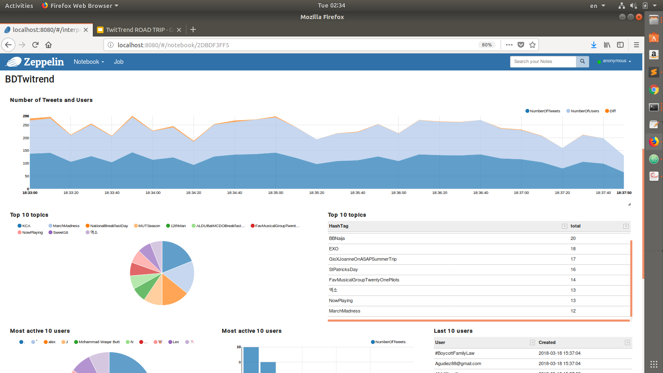
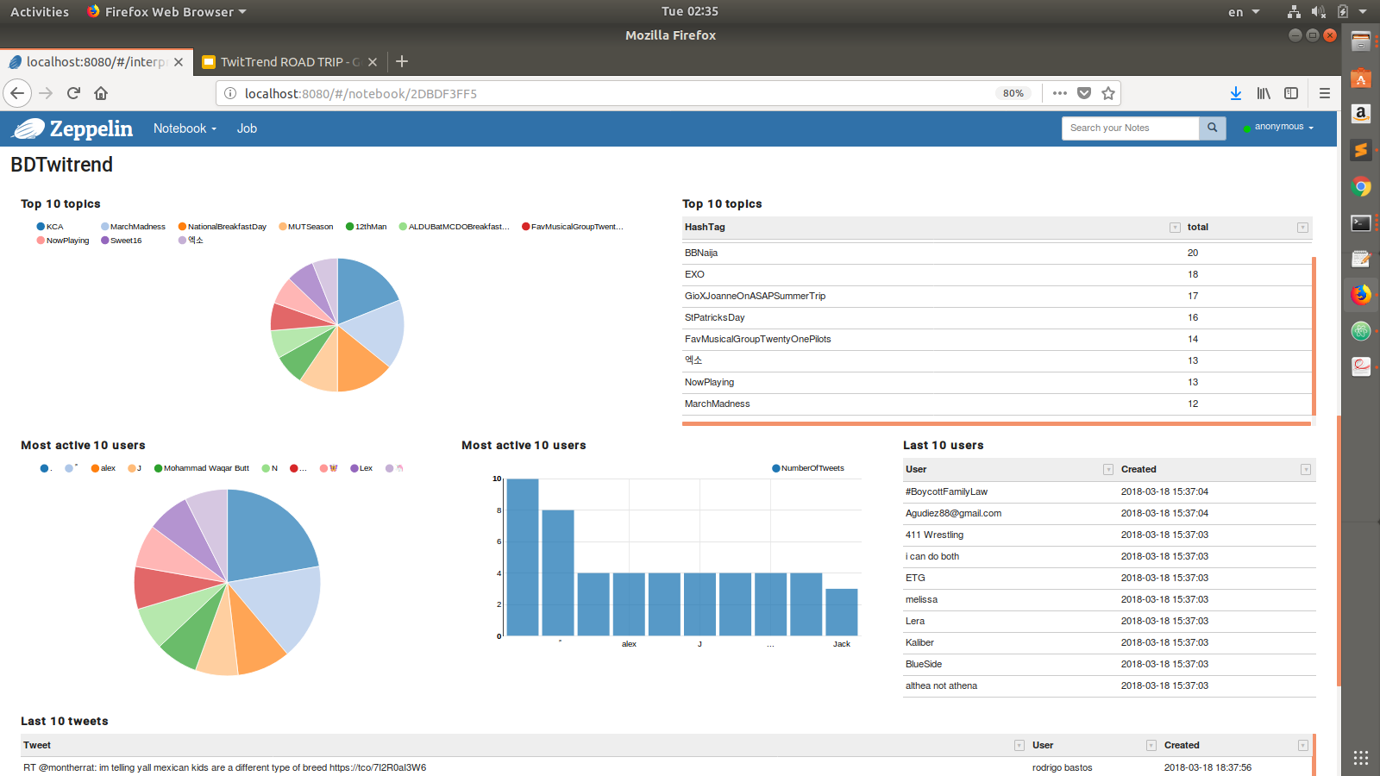
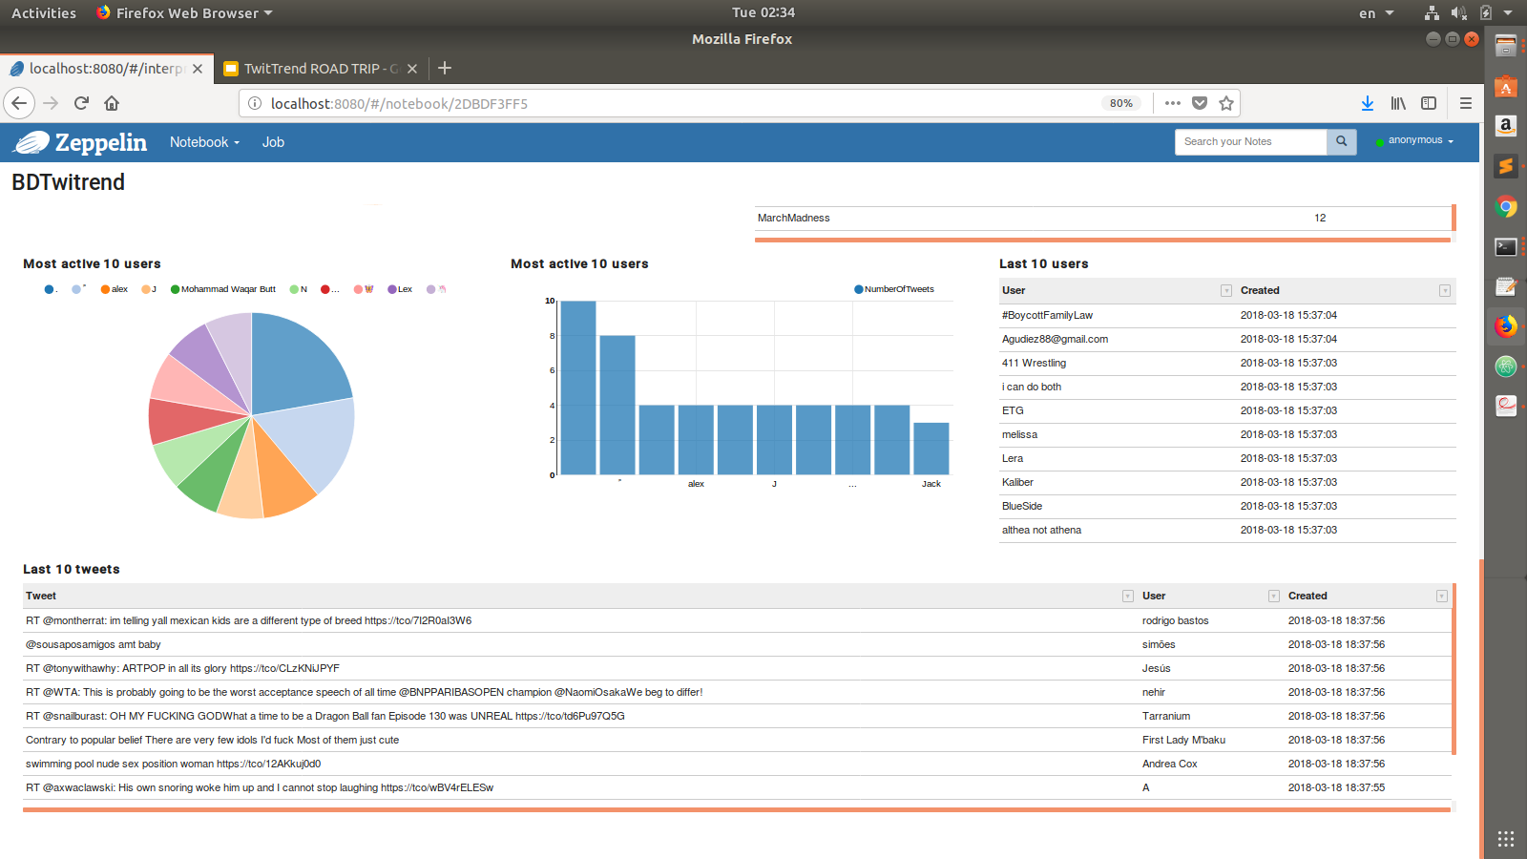
DEMO & CODE

Slide 13



General understanding about big data analyzing
How it works
How to set up local environment for Hadoop, HBase and Spark
How to use Apache Zeppelin and D3Js
How to implement real-time analysis using the tools
How to create Kafka producer and consumer
How to connect Spark Streaming and Kafka
How to connect Spark and HBase
Beginner with Scala
After a LONG JOURNEY,
I’ve just COME HOME.
https://github.com/bbatjargal/BDTwitrend

